Slide 1
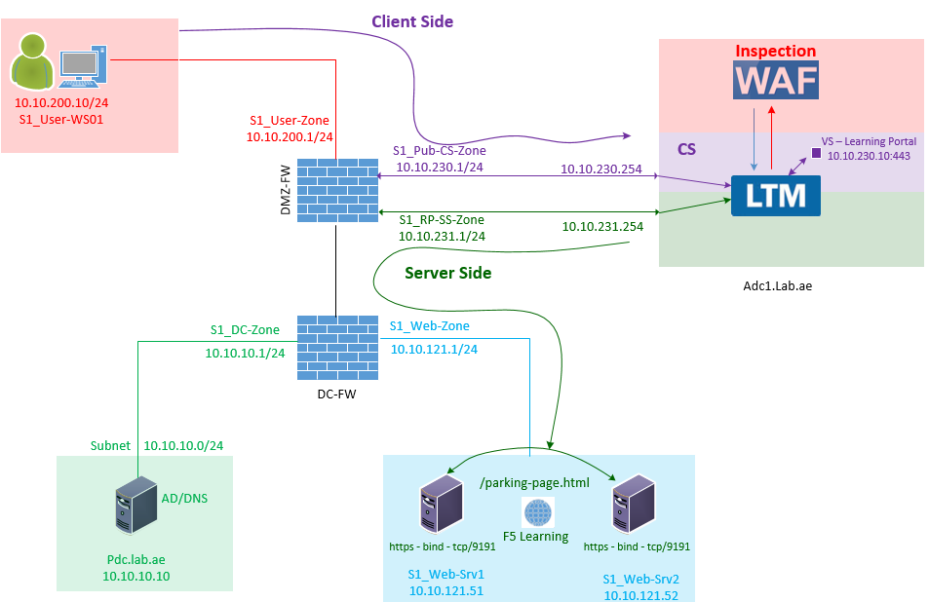

F5 LTM Learning with
Alexander S
Bonus Chapter 07 - Explore and configure the Source NAT profile in F5 LTM
Learning-Portal-Bridging_SNAT-Pool

Slide 2
What is a Source NAT (SNAT) Profile in F5 LTM?
F5 operates as a full reverse proxy.
As part of this full proxy architecture:
  F5 receives and terminates the client connection on the client-side Virtual Server.
  F5 performs security inspection using modules such as WAF.
  Once the security inspection is complete and the request is determined to be legitimate, F5 creates a new, separate connection to the backend server on behalf of the client.

Slide 3
What is the problem in using original Client IP as source?
The back-end web server receives and process this connection and return the response to client Ip.
This response go to the Firewall.
Firewall sees the response coming from the Server to original Client.
Actually, F5 is the one creates this connection behalf of the client.
But when the web server respond - it is skipping the F5 flow and send directly to the client.
Now firewall checks the stateful session table.
But it never found the session created from Client to Server directly.
Since no session found in session table firewall reset the connection.
This problem is called as Asymmetric routing problem.
What Happens Without SNAT?
Asymmetric Routing Problem
SRC - 10.10.200.10

Slide 4
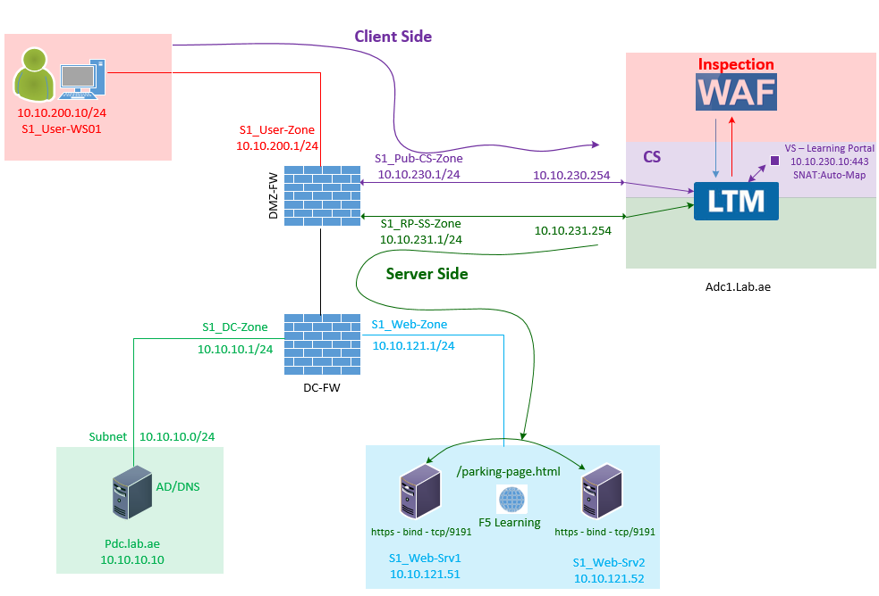
How to solve Asymmetric Routing Problem?
Using Source NAT (SNAT)
In reverse proxy Design, SNAT is mandatory.
Why because - To ensure return traffic always flows back through the F5, and this avoid asymmetric routing issues.

Slide 5
How to solve Asymmetric Routing Problem?
Using Source NAT (SNAT)
Let us see how SNAT solves asymmetric routing issues.
When F5 creates the server-side connection with SNAT , the backend server will not see the original client IP address as source.
Instead, the backend server will see the client IP as the F5 server side vlan Self IP.
The back-end web server receives and process this connection and return the response to F5 server side vlan Self IP.
This response go to the Firewall.
Firewall sees the response coming from the Server to F5 server side vlan Self IP.
Now firewall checks the stateful session table.

Slide 6
How to solve Asymmetric Routing Problem?
Using Source NAT (SNAT)
Let us see how SNAT solves asymmetric routing issues – Continued from the previous slide
Since these session was created by F5 server side vlan Self IP, it found the matching session and allow the response from web server to F5 server side vlan Self IP.
Now, F5 Virtual Server map this connection from Server Side Vlan Self Ip to Client-Side virtual Server IP.
The Client-Side Virtual Server receives these response and forward it to WAF for security inspection.
Once the security inspection done - If the F5 found the server response is legitimate
Then f5 forwards these response from F5 Virtual Server IP to the Original Client IP.
Therefore - In reverse proxy Design, SNAT is mandatory avoid asymmetric routing issues.

Slide 7
How to solve Asymmetric Routing Problem?
Using Source NAT (SNAT)
Let us see how SNAT solves asymmetric routing issues – Continued from the previous slide
Since these session was created by F5 server side vlan Self IP, it found the matching session and allow the response from web server to F5 server side vlan Self IP.
Now, F5 Virtual Server map this connection from Server Side Vlan Self Ip to Client-Side virtual Server IP.
The Client-Side Virtual Server receives these response and forward it to WAF for security inspection.
Once the security inspection done - If the F5 found the server response is legitimate
Then f5 forwards these response from F5 Virtual Server IP to the Original Client IP.
Therefore - In reverse proxy Design, SNAT is mandatory avoid asymmetric routing issues.

Slide 8
Quiz Time ?
Will always F5 uses the Server Side Vlan Self Ip to create the back-end connection?
Great Question!!!
The answer is No - Not always! It is purely based on design and configurations.

Slide 9
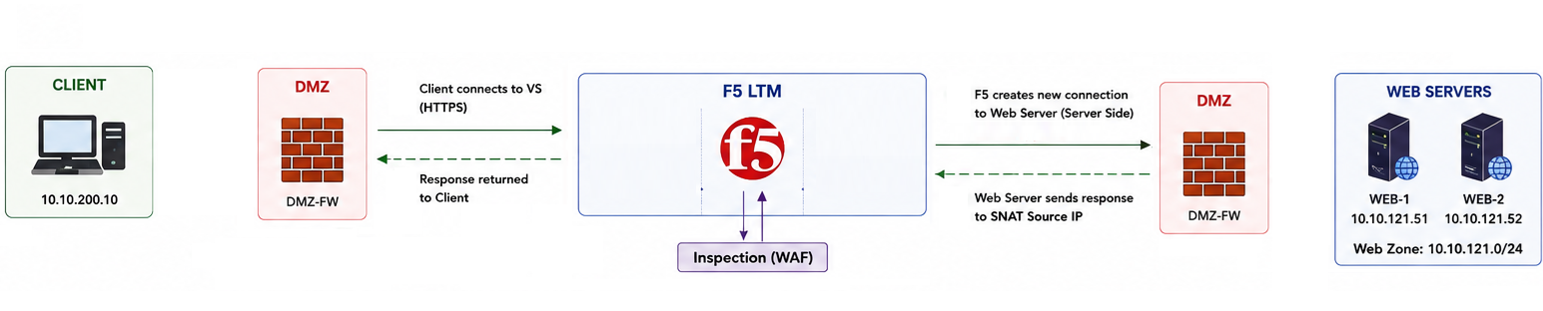
Standalone F5 device - SNAT Type Auto Map
In standalone F5 device
When you configure the Virtual Server and in this Virtual Server configuration if you choose the SNAT type as Auto Map, then this Virtual Server server-side connection created using server-side VLAN Self IP.
Client-Side Subnet
10.10.230.0/24
Server-Side Subnet
10.10.231.0/24
10.10.230.1
10.10.230.254
10.10.231.254
10.10.231.1
Learning-Portal-Vs
10.10.230.10
SNAT-Type
Auto-Map
10.10.231.254

Slide 10
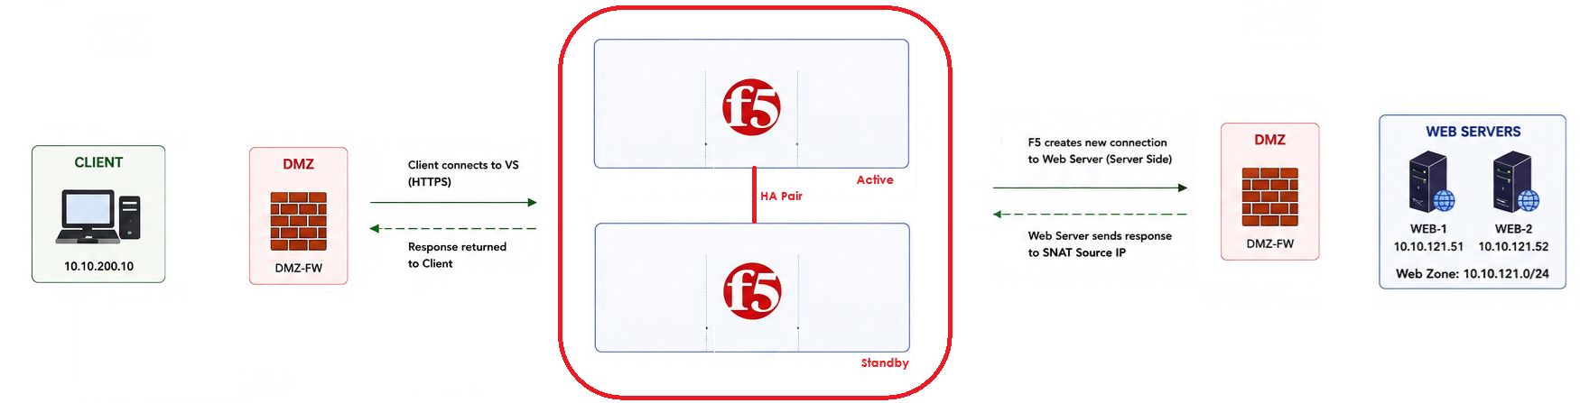
HA-Pair F5 device - SNAT Type Auto Map
In HA-Pair F5 devices
When you configure the Virtual Server and in this Virtual Server, configuration if you choose the SNAT type as Auto Map, then this Virtual Server server-side connection created using server-side VLAN Floating IP.
Client-Side Subnet
10.10.230.0/24
Learning-Portal-Vs
10.10.230.10
SNAT-Type
Auto-Map
10.10.231.252
Server-Side Subnet
10.10.231.0/24
Self
10.10.230.253
Self
10.10.231.253
10.10.231.1
10.10.230.1
Float-10.10.230.252
Float-10.10.231.252
Self
10.10.230.254
Self
10.10.231.254
Learning-Portal-Vs
10.10.230.10
SNAT-Type
Auto-Map
10.10.231.252

Slide 11
Standalone or HA-Pair F5 devices - SNAT Type is SNAT Pool
When you configure the Virtual Server and in this Virtual Server configuration if you choose the SNAT type as SNAT pool, then this server-side connection created using one of the SNAT pool IP.
Client-Side Subnet
10.10.230.0/24
Server-Side Subnet
10.10.231.0/24
10.10.230.1
10.10.230.254
10.10.231.254
10.10.231.1
Learning-Portal-Vs
10.10.230.10
SNAT-Pool
Learning-Portal-SNAT
10.10.231.10
Client-Side Subnet
10.10.230.0/24
Learning-Portal-Vs
10.10.230.10
SNAT-Pool
Learning-Portal-SNAT
10.10.231.10
Server-Side Subnet
10.10.231.0/24
Self
10.10.230.253
Self
10.10.231.253
10.10.231.1
10.10.230.1
Float-10.10.230.252
Float-10.10.231.252
Self
10.10.230.254
Self
10.10.231.254
Learning-Portal-Vs
10.10.230.10
SNAT-Pool
Learning-Portal-SNAT
10.10.231.10

Slide 12
Quiz Time ? Why Auto Map Chooses the Server Side Vlan Self Ip ?
Why does F5 choose the server-side VLAN Self IP to create the server-side connection when the SNAT type is configured as SNAT Automap?
Why doesn't it use the client-side VLAN Self IP instead?
There are two answers for this question.

Slide 13

First Answer - Standalone F5 device - SNAT Type - Auto Map IP selection
(Route-Based Self IP Selection)
In a single F5 design
  First F5 checks how many Self IP configured on F5.
  In our case it is two.
    Client Side Self Ip and
    Server Side Self Ip.
  Then F5 checks routing.
    Since the Server-Side subnet Routing configured using Server Side vlan interface.
    It picks Server Side Vlan Self IP which is 10.10.231.254 to create server-side connection.
Client-Side Subnet
10.10.230.0/24
Server-Side Subnet
10.10.231.0/24
10.10.230.1
10.10.230.254
10.10.231.254
10.10.231.1
Learning-Portal-Vs
10.10.230.10
SNAT-Type
Auto-Map
10.10.231.254

Slide 14
Second Answer - F5 HA-Pair Design - SNAT Type - Auto Map IP selection
(Route-Based Floating IP Selection)
In a HA-Pair of F5 design
First F5 checks how many Floating IP's configured on F5.
In our case it is two.
  Client Side Floating Ip and
  Server Side Floating Ip.
Then F5 checks routing.
  Since the Server-Side subnet Routing configured using Server Side vlan interface
  It picks Server Side Vlan Floating IP which is 10.10.231.252
Client-Side Subnet
10.10.230.0/24
Learning-Portal-Vs
10.10.230.10
SNAT-Type
Auto-Map
10.10.231.252
Server-Side Subnet
10.10.231.0/24
Self
10.10.230.253
Self
10.10.231.253
10.10.231.1
10.10.230.1
Float-10.10.230.252
Float-10.10.231.252
Self
10.10.230.254
Self
10.10.231.254
Learning-Portal-Vs
10.10.230.10
SNAT-Type
Auto-Map
10.10.231.252

Slide 15
Quiz Time ? What if I delete the Server-Side Vlan Floating IP
I am going to ask another tricky question here?
By mistake, I deleted the Server-Side Floating IP and still client-Side Floating IP is active and Server-Side subnet Routing configured using Server Side vlan interface
Now, Which IP F5 should take to create the server-side connection?
Client-Side Subnet
10.10.230.0/24
Learning-Portal-Vs
10.10.230.10
SNAT-Type
Auto-Map
10.10.231.252
Server-Side Subnet
10.10.231.0/24
Self
10.10.230.253
Self
10.10.231.253
10.10.231.1
10.10.230.1
Float-10.10.230.252
Float-10.10.231.252
Self
10.10.230.254
Self
10.10.231.254
Learning-Portal-Vs
10.10.230.10
SNAT-Type
Auto-Map
10.10.231.252

Slide 16
Quiz Time ? What if I delete the Server-Side Vlan Floating IP
I am going to ask another tricky question here?
By mistake, I deleted the Server-Side Floating IP and still client-Side Floating IP is active and Server-Side subnet Routing configured using Server Side vlan interface
Now, Which IP F5 should take to create the server-side connection?
Client-Side Subnet
10.10.230.0/24
Learning-Portal-Vs
10.10.230.10
SNAT-Type
Auto-Map
???
Server-Side Subnet
10.10.231.0/24
Self
10.10.230.253
Self
10.10.231.253
10.10.231.1
10.10.230.1
Float-10.10.230.252
Self
10.10.230.254
Self
10.10.231.254
Learning-Portal-Vs
10.10.230.10
SNAT-Type
Auto-Map
???

Slide 17
Quiz Time ? Which one takes priority?
Routing or Floating-IP?
If routing is considered as priority - F5 should choose to use Server Side Vlan Self IP
If floating Ip is considered as priority - F5 should choose to use Client-Side Floating IP
Client-Side Subnet
10.10.230.0/24
Learning-Portal-Vs
10.10.230.10
SNAT-Type
Auto-Map
10.10.231.253
Server-Side Subnet
10.10.231.0/24
Self
10.10.230.253
Self
10.10.231.253
10.10.231.1
10.10.230.1
Float-10.10.230.252
Self
10.10.230.254
Self
10.10.231.254
Learning-Portal-Vs
10.10.230.10
SNAT-Type
Auto-Map
10.10.231.254

Slide 18
Quiz Time ? Which one takes priority?
Routing or Floating-IP?
If routing is considered as priority - F5 should choose to use Server Side Vlan Self IP
If floating Ip is considered as priority - F5 should choose to use Client-Side Floating IP
Client-Side Subnet
10.10.230.0/24
Learning-Portal-Vs
10.10.230.10
SNAT-Type
Auto-Map
10.10.230.252
Server-Side Subnet
10.10.231.0/24
Self
10.10.230.253
Self
10.10.231.253
10.10.231.1
10.10.230.1
Float-10.10.230.252
Self
10.10.230.254
Self
10.10.231.254
Learning-Portal-Vs
10.10.230.10
SNAT-Type
Auto-Map
10.10.230.252

Slide 19
Quiz Time ? Which one takes priority?
Floating IP takes the priority over the Routing.
Great thinking!!! The correct Answer is
The floating Ip is considered as priority over the routing and F5 will use Client-Side Floating IP to create the connection
Client-Side Subnet
10.10.230.0/24
Learning-Portal-Vs
10.10.230.10
SNAT-Type
Auto-Map
10.10.230.252
Server-Side Subnet
10.10.231.0/24
Self
10.10.230.253
Self
10.10.231.253
10.10.231.1
10.10.230.1
Float-10.10.230.252
Self
10.10.230.254
Self
10.10.231.254
Learning-Portal-Vs
10.10.230.10
SNAT-Type
Auto-Map
10.10.230.252

Slide 20
The Source NAT Automap IP selection process
(First → Prefer a Floating Self IP if one is available)
Prefer a Floating Self IP if one is available.
If multiple Floating Self IPs exist, select the one that best matches the route to the destination.
If no Floating Self IP is available, use a Non-Floating Self IP.
If multiple Non-Floating Self IPs exist, select the one that best matches the route to the destination.
Client-Side Subnet
10.10.230.0/24
Learning-Portal-Vs
10.10.230.10
SNAT-Type
Auto-Map
10.10.231.252
Server-Side Subnet
10.10.231.0/24
Self
10.10.230.253
Self
10.10.231.253
10.10.231.1
10.10.230.1
Float-10.10.230.252
Float-10.10.231.252
Self
10.10.230.254
Self
10.10.231.254
Learning-Portal-Vs
10.10.230.10
SNAT-Type
Auto-Map
10.10.231.252

Slide 21
The Source NAT Automap IP selection process
(Second - If multiple Floating Self IPs exist, select the one that best matches the route to the destination)
Prefer a Floating Self IP if one is available.
If multiple Floating Self IPs exist, select the one that best matches the route to the destination.
If no Floating Self IP is available, use a Non-Floating Self IP.
If multiple Non-Floating Self IPs exist, select the one that best matches the route to the destination.
Client-Side Subnet
10.10.230.0/24
Learning-Portal-Vs
10.10.230.10
SNAT-Type
Auto-Map
10.10.231.252
Server-Side Subnet
10.10.231.0/24
Self
10.10.230.253
Self
10.10.231.253
10.10.231.1
10.10.230.1
Float-10.10.230.252
Float-10.10.231.252
Self
10.10.230.254
Self
10.10.231.254
Learning-Portal-Vs
10.10.230.10
SNAT-Type
Auto-Map
10.10.231.252

Slide 22
The Source NAT Automap IP selection process
(Third - If no Floating Self IP is available, use a Non-Floating Self IP)
Prefer a Floating Self IP if one is available.
If multiple Floating Self IPs exist, select the one that best matches the route to the destination.
If no Floating Self IP is available, use a Non-Floating Self IP.
If multiple Non-Floating Self IPs exist, select the one that best matches the route to the destination.
Client-Side Subnet
10.10.230.0/24
Learning-Portal-Vs
10.10.230.10
SNAT-Type
Auto-Map
10.10.231.253
Server-Side Subnet
10.10.231.0/24
Self
10.10.230.253
Self
10.10.231.253
10.10.231.1
10.10.230.1
Self
10.10.230.254
Self
10.10.231.254
Learning-Portal-Vs
10.10.230.10
SNAT-Type
Auto-Map
10.10.231.254

Slide 23
The Source NAT Automap IP selection process
(Fourth - If multiple Non-Floating Self IPs exist, select the one that best matches the route to the destination.)
Prefer a Floating Self IP if one is available.
If multiple Floating Self IPs exist, select the one that best matches the route to the destination.
If no Floating Self IP is available, use a Non-Floating Self IP.
If multiple Non-Floating Self IPs exist, select the one that best matches the route to the destination.
Client-Side Subnet
10.10.230.0/24
Learning-Portal-Vs
10.10.230.10
SNAT-Type
Auto-Map
10.10.231.253
Server-Side Subnet
10.10.231.0/24
Self
10.10.230.253
Self
10.10.231.253
10.10.231.1
10.10.230.1
Self
10.10.230.254
Self
10.10.231.254
Learning-Portal-Vs
10.10.230.10
SNAT-Type
Auto-Map
10.10.231.254

Slide 24
The Source NAT Automap IP selection process
In this example the preferred order would be:
Server VLAN Floating IP (10.10.231.252)
Client VLAN Floating IP (10.10.230.252)
Server VLAN Self IP (10.10.231.253)
Client VLAN Self IP (10.10.230.253)
Client-Side Subnet
10.10.230.0/24
Learning-Portal-Vs
10.10.230.10
SNAT-Type
Auto-Map
10.10.231.252
Server-Side Subnet
10.10.231.0/24
Self
10.10.230.253
Self
10.10.231.253
10.10.231.1
10.10.230.1
Float-10.10.230.252
Float-10.10.231.252
Self
10.10.230.254
Self
10.10.231.254
Learning-Portal-Vs
10.10.230.10
SNAT-Type
Auto-Map
10.10.231.252

Slide 25
The Source NAT Automap IP selection process
In this example the preferred order would be:
Server VLAN Floating IP (10.10.231.252)
Client VLAN Floating IP (10.10.230.252)
Server VLAN Self IP (10.10.231.253)
Client VLAN Self IP (10.10.230.253)
Client-Side Subnet
10.10.230.0/24
Learning-Portal-Vs
10.10.230.10
SNAT-Type
Auto-Map
10.10.230.252
Server-Side Subnet
10.10.231.0/24
Self
10.10.230.253
Self
10.10.231.253
10.10.231.1
10.10.230.1
Float-10.10.230.252
Self
10.10.230.254
Self
10.10.231.254
Learning-Portal-Vs
10.10.230.10
SNAT-Type
Auto-Map
10.10.230.252

Slide 26
Source NAT – Key Take Away
In a reverse proxy design, SNAT is mandatory to avoid asymmetric routing issues.
When SNAT is enabled, the F5 replaces the client's IP address with its own source IP address before forwarding the request to the backend server.
Because of this, the backend server sends its response back to the F5 instead of sending it directly to the client.
The return traffic is sent to:
  The Server-Side Self IP in a standalone F5 deployment.
  The Floating Self IP in an HA pair deployment.
  A SNAT Pool IP when a SNAT pool is configured.
This ensures that client requests and web server responses flow through the F5 in both directions.
As a result, the F5 can inspect and manage both client requests and server responses.

Slide 27
Source NAT – Key Take Away
(Standalone F5 Deployment)
The return traffic is sent to:
  The Server-Side Self IP in a standalone F5 deployment.
  The Floating Self IP in an HA pair deployment.
  A SNAT Pool IP when a SNAT pool is configured.
Client-Side Subnet
10.10.230.0/24
Server-Side Subnet
10.10.231.0/24
10.10.230.1
10.10.230.254
10.10.231.254
10.10.231.1
Learning-Portal-Vs
10.10.230.10
SNAT-Type
Auto-Map
10.10.231.254

Slide 28
Source NAT – Key Take Away
(HA Pair Design)
The return traffic is sent to:
  The Server-Side Self IP in a standalone F5 deployment.
  The Floating Self IP in an HA pair deployment.
  A SNAT Pool IP when a SNAT pool is configured.
Client-Side Subnet
10.10.230.0/24
Learning-Portal-Vs
10.10.230.10
SNAT-Type
Auto-Map
10.10.231.252
Server-Side Subnet
10.10.231.0/24
Self
10.10.230.253
Self
10.10.231.253
10.10.231.1
10.10.230.1
Float-10.10.230.252
Float-10.10.231.252
Self
10.10.230.254
Self
10.10.231.254
Learning-Portal-Vs
10.10.230.10
SNAT-Type
Auto-Map
10.10.231.252

Slide 29
Source NAT – Key Take Away
(A SNAT Pool IP - Regardless of Design)
The return traffic is sent to:
  The Server-Side Self IP in a standalone F5 deployment.
  The Floating Self IP in an HA pair deployment.
  A SNAT Pool IP when a SNAT pool is configured.
Client-Side Subnet
10.10.230.0/24
Server-Side Subnet
10.10.231.0/24
10.10.230.1
10.10.230.254
10.10.231.254
10.10.231.1
Learning-Portal-Vs
10.10.230.10
SNAT-Pool
Learning-Portal-SNAT
10.10.231.10

Slide 30
This LAB contains Four Virtual Server Design
Design 1 – Load Balancing Virtual server using Auto MAP
Design I1 – Load Balancing with Port Forwarding Virtual server using Auto MAP
Design I1I – SSL Offloading Virtual server using SNAT Pool
Design IV – SSL Bridging Virtual server using SNAT Pool

Slide 31
Design 1 – Load Balancing Virtual server using Auto MAP
In this case, we create the learning portal Virtual Server name as Learning-Portal-LB_Vs
For the Client-Side connection,
  We will assign the virtual Server IP address from client side vlan which is 10.10.230.21
  Since this Virtual Server does only the load balancing,
    Virtual Server port becomes the same port as the backend pool member port which is 8181.
For the Server-Side connection,
  We will use source address translation (SNAT) type as Auto Map
  Since it is single F5 and SNAT type is auto map. It looks the routing first.
  The server-side subnet 10.10.121.0/24 (which is part of the 10.10.0.0/16) routing configured using Server Side Vlan interface as Gate Way.
  Since Server-Side Routing configured using Server Side vlan Interface,
    It picks Server Side Vlan Self IP which is 10.10.231.254 to create the server side SNAT connection.
Client-Side Subnet
10.10.230.0/24
Server-Side Subnet
10.10.231.0/24
10.10.230.1
10.10.230.254
10.10.231.254
10.10.231.1
Learning-Portal-LB_Vs
10.10.230.21:8181
SNAT-Type
Auto-Map
10.10.231.254
Custom Plain Text Port 8181

Slide 32
Design I1 – Load Balancing with Port Forwarding Virtual server using Auto MAP
In this case, we create the learning portal Virtual Server name as Learning-Portal-PF_Vs
For the Client-Side connection,
  We will assign the virtual Server IP address from client side vlan which is 10.10.230.22
  Since this Virtual Server does the Load Balancing and Port Forwarding,
    Virtual Server port becomes 80 and F5 translate this port from 80 to 8181 - when it creates the backend connection.
    For the Server-Side connection,
  We will use source address translation (SNAT) type as Auto Map
  Since it is single F5 and SNAT type is auto map. It looks the routing first.
  The server-side subnet 10.10.121.0/24 (which is part of the 10.10.0.0/16) routing configured using Server Side Vlan interface as Gate Way.
  Since Server-Side Routing configured using Server Side vlan Interface,
    It picks Server Side Vlan Self IP which is 10.10.231.254 to create the server side SNAT connection.
Client-Side Subnet
10.10.230.0/24
Server-Side Subnet
10.10.231.0/24
10.10.230.1
10.10.230.254
10.10.231.254
10.10.231.1
80
8181
Learning-Portal-PF_Vs
10.10.230.22:80
SNAT-Type
Auto-Map
10.10.231.254
Custom Plain Text Port 8181

Slide 33
Design I1I – SSL Offloading Virtual server using SNAT Pool
In this case, we create the learning portal Virtual Server name as Learning-Portal-Offload_Vs
For the Client-Side connection,
  We will assign the virtual Server IP address from client side vlan which is 10.10.230.23
  Since this Virtual Server does the SSL Offloading,
    Virtual Server port becomes 443 and F5 translate this port from 443 to 8181 - when it creates the backend connection.
    For the Server-Side connection,
  We will create the SNAT pool as Learning-Portal-Offload_SNAT-Pool and assign the SNAT IP address from server side vlan which is 10.10.231.23.
  Since we use SNAT pool - F5 uses the assigned SNAT IP which is 10.10.231.23 to create the server-side connection.
Client-Side Subnet
10.10.230.0/24
Server-Side Subnet
10.10.231.0/24
10.10.230.1
10.10.230.254
10.10.231.254
10.10.231.1
Learning-Portal-Offload_Vs
10.10.230.23:443
SNAT-Pool
Learning-Portal-Offload_SNAT-Pool
10.10.231.23
443
8181
Custom Plain Text Port 8181

Slide 34
Design IV – SSL Bridging Virtual server using SNAT Pool
In this case, we create the learning portal Virtual Server name as Learning-Portal-Bridging_Vs
For the Client-Side connection,
  We will assign the virtual Server IP address from client side vlan which is 10.10.230.10
  Since this Virtual Server does the SSL Bridging,
    Virtual Server port becomes 443 and F5 translate this port from 443 to custom SSL port 9191 - when it creates the backend connection.
    For the Server-Side connection,
  We will create the SNAT pool as Learning-Portal-Bridging_SNAT-Pool and assign the SNAT IP address from server side vlan which is 10.10.231.10.
  Since we use SNAT pool - F5 uses the assigned SNAT IP which is 10.10.231.10 to create the server-side connection.
Client-Side Subnet
10.10.230.0/24
Server-Side Subnet
10.10.231.0/24
10.10.230.1
10.10.230.254
10.10.231.254
10.10.231.1
Learning-Portal-Bridging_Vs
10.10.230.10:443
SNAT-Pool
Learning-Portal-Bridging_SNAT-Pool
10.10.231.10
443
9191
Custom SSL Port 9191

Slide 35
Bonus Chapter 07 - Explore and configure the Source NAT profile in F5 LTM
I hope this video helped you understand and configure SNAT profiles in F5.
Later, when you configure the different types of Virtual Servers, you will assign these SNAT pools.
This brings us to the end of Bonus Chapter 07.
Thank you for watching.
Learning-Portal-Bridging_SNAT-Pool

